Slide 1
Markov Chain Monte Carlo: Fundamentals Part I
An introduction to sampling techniques and Monte Carlo

Slide 2

About Me
Name: Hong
SharpestMinds mentee
Bachelor of Commerce specializing in Actuarial Science, Econometrics and Finance (2018)
Studied one unit of Bayesian statistics
Interested in sports analytics

Slide 3
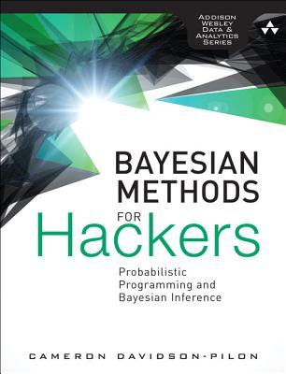
?
?
?
?
“…if you can write a for-loop you can do statistics. Statistics as a discipline is so mired in its own bullshit formalism that it gets in the way of doing what is important…” – Goodreads review
“Frequentist methods are still useful or state-of-the-art in many areas. Tools such as least squares linear regression, LASSO regression, and expectation-maximization algorithms are all powerful and fast.” – Bayesian Methods for Hackers
?
?
?
?
?
?
?
?
?
?
?
?
“Bayesian inference differs from more traditional statistical inference by preserving uncertainty” – Bayesian Methods for Hackers
?
?
?
?
“But it seems very difficult to find an explanation of Markov Chain Monte Carlo without superfluous jargon. The “bullshit” here is the implicit claim of an author that such jargon is needed.” - An angry computer scientist
?
?

Slide 4

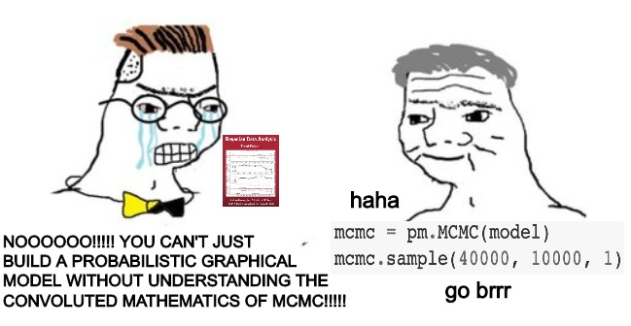




Slide 5
A recap of Bayesian inference

Slide 6

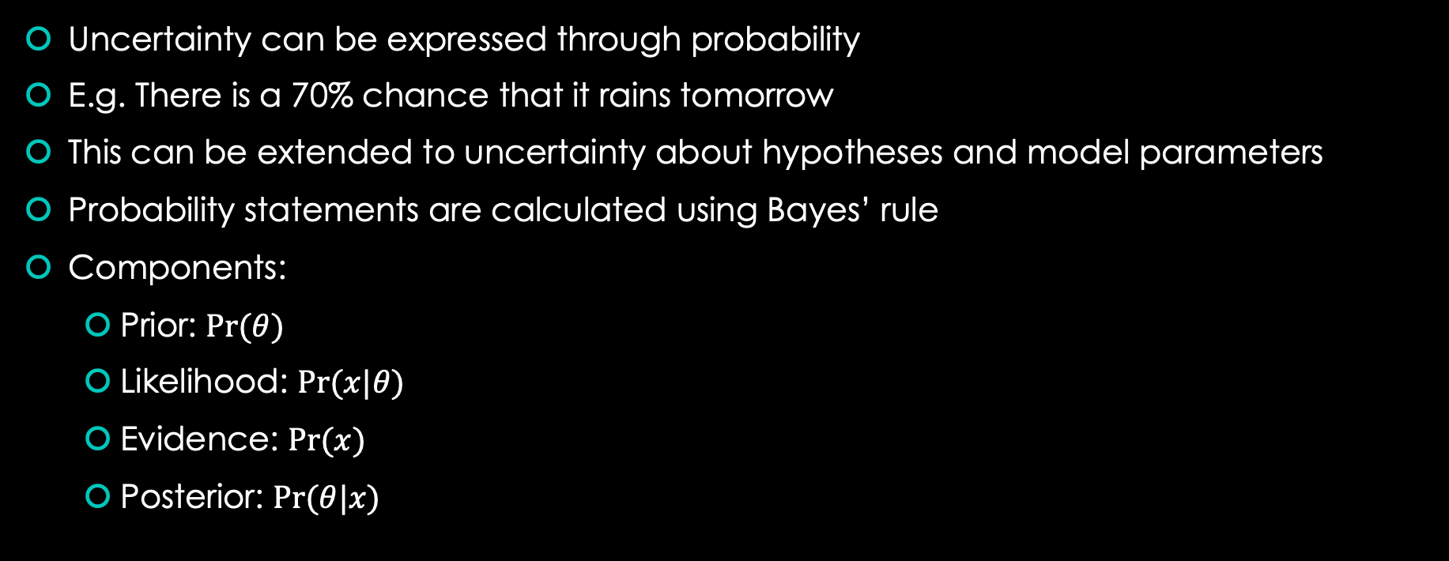
The Bayesian worldview
Uncertainty can be expressed through probability
E.g. There is a 70% chance that it rains tomorrow
This can be extended to uncertainty about hypotheses and model parameters
Probability statements are calculated using Bayes’ rule
Components:
Prior: $Pr⁡(θ)$
Likelihood: $Pr⁡(x|θ)$
Evidence: $Pr⁡(x)$
Posterior: $Pr⁡(θ|x)$
$$p\left(θ | x\right)=\frac{p\left(x | θ\right)p⁡(θ)}{p⁡(x)}$$

Slide 7
Advantages of Bayesian Inference
Probability statements are more intuitive
Non-statisticians (and sometimes statisticians!) will usually misinterpret frequentist results e.g. confidence intervals
Can incorporate information from sequences of experiments
Frequentist experiment design needs to be done very carefully
Null hypothesis testing can be subject to p-hacking
Valid results regardless of sample size
Frequentist statistics tends to appeal to asymptotic results
Lends itself well to the paradigm of probabilistic programming
Relationships between variables are mapped using computational graphs
Bayes rule provides a natural way to perform inference on such models

Slide 8
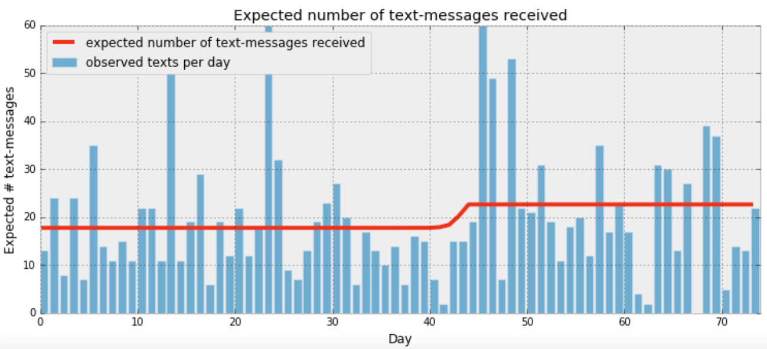

Slide 9
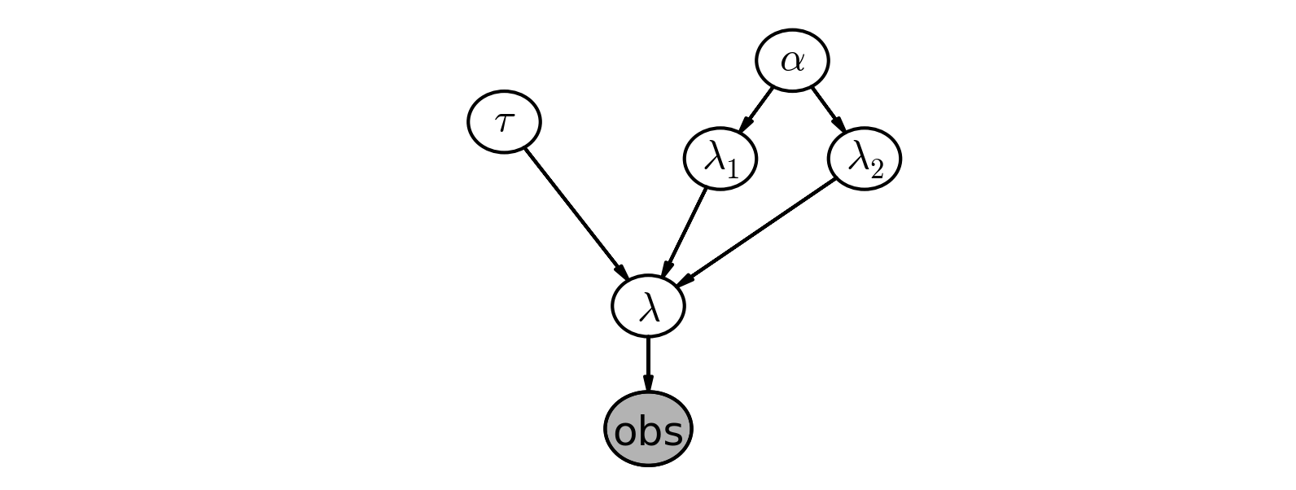

Slide 10

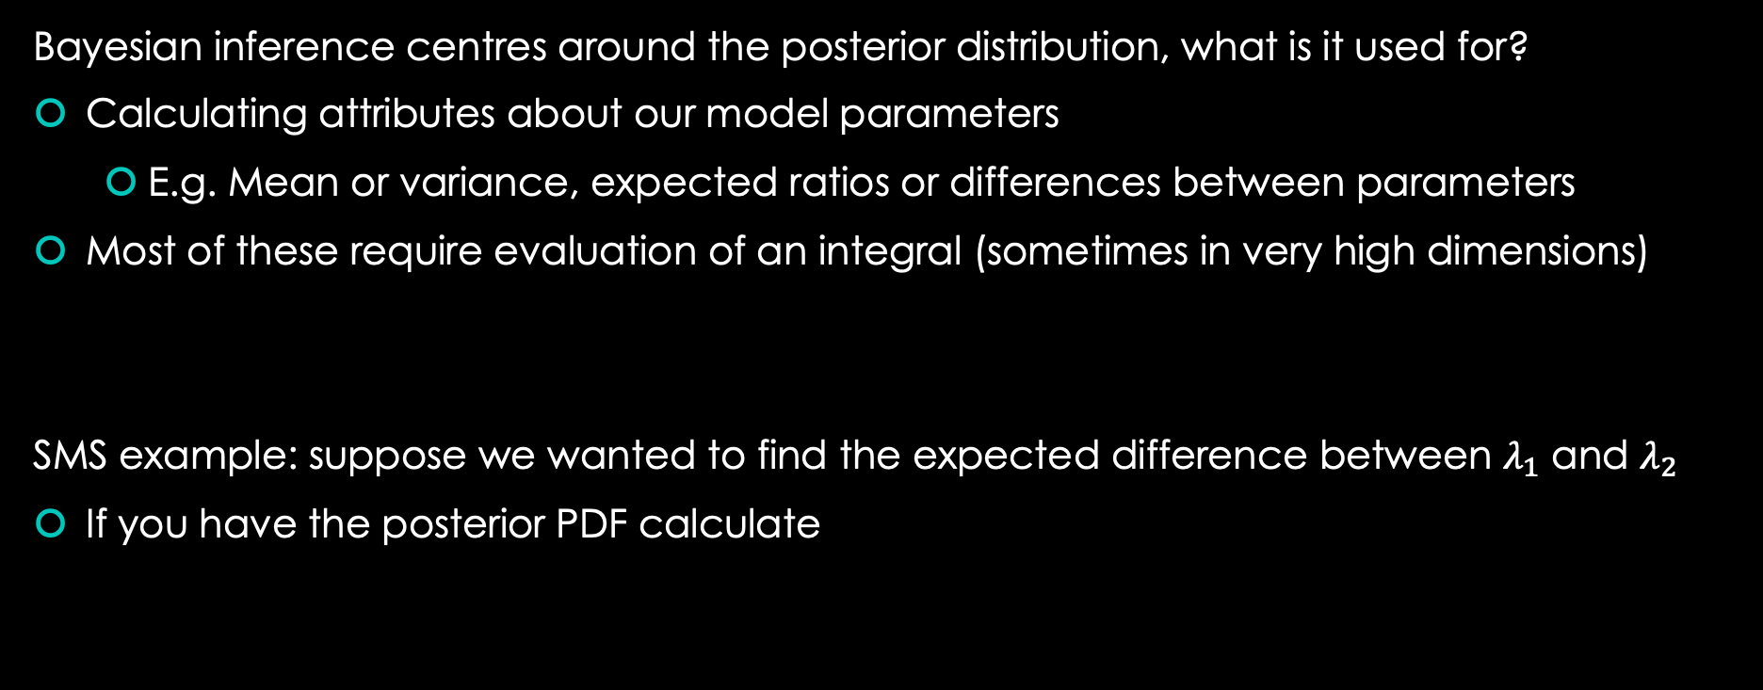

Why do we need Monte Carlo?
Bayesian inference centres around the posterior distribution, what is it used for?
Calculating attributes about our model parameters
E.g. Mean or variance, expected ratios or differences between parameters
Most of these require evaluation of an integral (sometimes in very high dimensions)
SMS example: suppose we wanted to find the expected difference between $λ_{1}$ and $λ_{2}$
If you have the posterior PDF calculate
$$E\left[h\left(θ\right) | x\right)]=∫h\left(θ\right)p\left(θ | x\right)dθ$$
$$E\left[λ_{1}−λ_{2}|x\right]= \int{…\int{(λ_{1}−λ_{2})p\left(λ,λ_{1}, λ_{2}, τ,α|x\right)dλdλ_{1}dλ_{2}dτdα }}$$

Slide 11
Monte Carlo
Randomly generating numbers and crossing your fingers

Slide 12
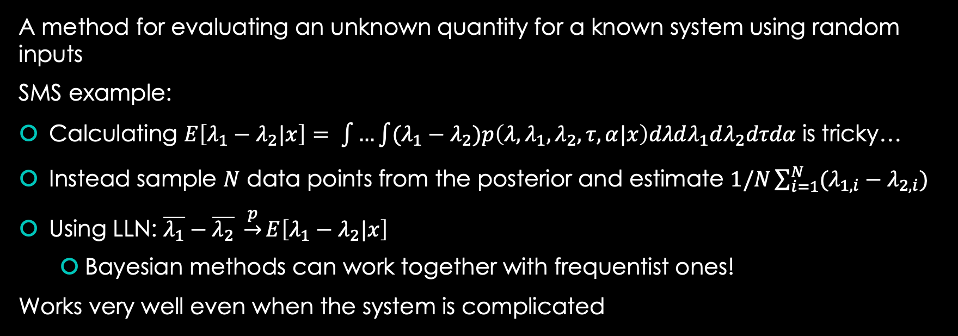
What is Monte Carlo?
A method for evaluating an unknown quantity for a known system using random inputs
SMS example:
Calculating $E\left[λ_{1}−λ_{2}|x\right]= \int{…\int{(λ_{1}−λ_{2})p\left(λ,λ_{1}, λ_{2}, τ,α|x\right)dλdλ_{1}dλ_{2}dτdα }}$is tricky…
Instead sample $N$ data points from the posterior and estimate $1/N\sum_{i=1}^{N}{(λ_{1,i}−λ_{2,i})}$
Using LLN: $\overline{λ_{1}}−\overline{λ_{2}} \underset{→}{p}E\left[λ_{1}−λ_{2}|x\right]$
Bayesian methods can work together with frequentist ones!
Works very well even when the system is complicated

Slide 13
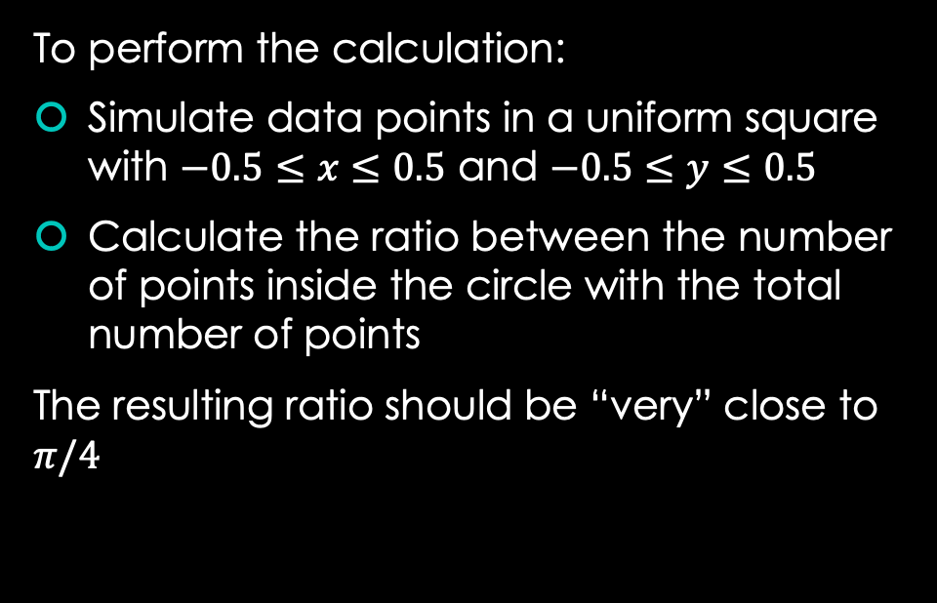
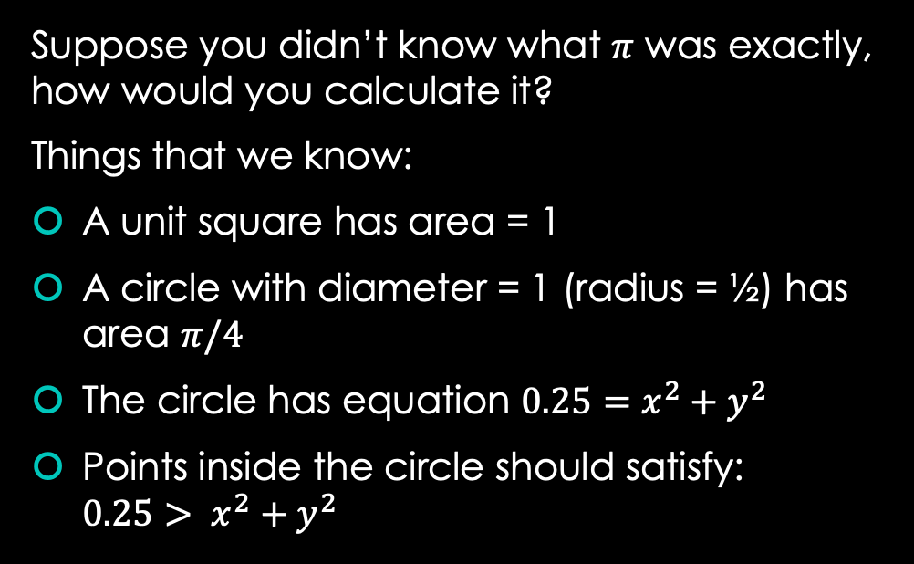
Pi calculation example
Suppose you didn’t know what $π$ was exactly, how would you calculate it?
Things that we know:
A unit square has area = 1
A circle with diameter = 1 (radius = ½) has area $π/4$
The circle has equation $0.25=x^{2}+y^{2}$
Points inside the circle should satisfy: $0.25> x^{2}+y^{2}$
To perform the calculation:
Simulate data points in a uniform square with $−0.5≤x≤0.5$ and $−0.5≤y≤0.5$
Calculate the ratio between the number of points inside the circle with the total number of points
The resulting ratio should be “very” close to $π/4$

Slide 14
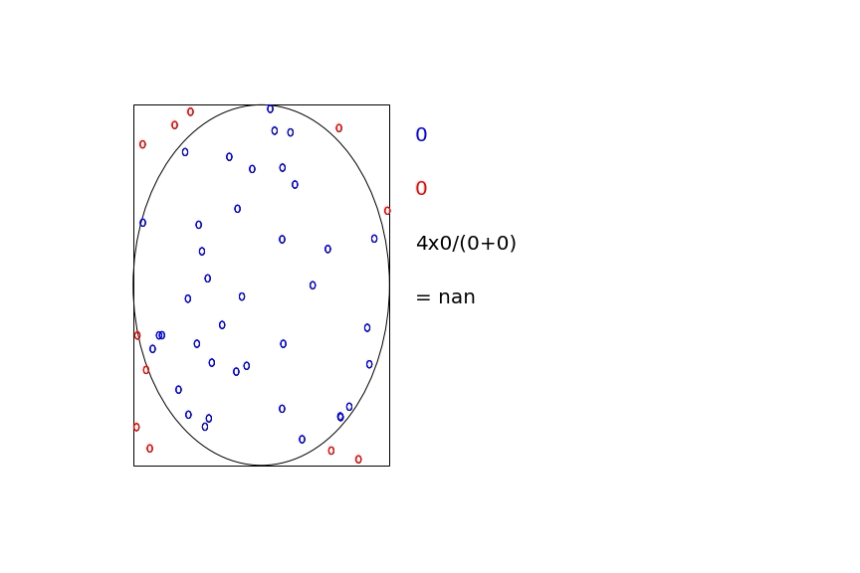

Slide 15

Some math
Chain rule of probability:
Joint, marginal and conditional distributions
$$p\left(θ_{1},θ_{2}, θ_{3}\right)=p\left(θ_{1},θ_{2} | θ_{3}\right)p\left(θ_{3}\right)=p\left(θ_{1} | θ_{2},θ_{3}\right)p\left(θ_{2}|θ_{3}\right)p(θ_{3})$$
$$p\left(θ_{1}\right)= \int{\int{p\left(θ_{1},θ_{2}, θ_{3}\right) }dθ_{2}dθ_{3}}, p\left(θ_{1} | θ_{2}, θ_{3}\right)=\frac{p\left(θ_{1}, θ_{2}, θ_{3}\right)}{p(θ_{2}, θ_{3})}$$

Slide 16
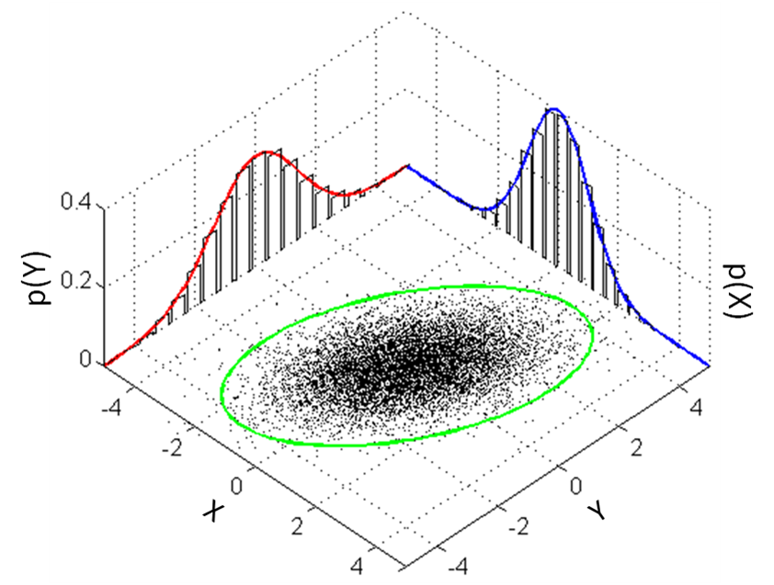

Slide 17



Some math
Kernel of a density for $θ_{1}\sim N(μ, σ^{2})$
Integrating/normalising constant of a kernel
$$p\left(θ_{1}\right)=\frac{1}{\sqrt{2πσ^{2}}}\exp{\{−\frac{{\left(θ_{1}−μ\right)}^{2}}{2σ^{2}}\}}∝q\left(θ_{1}\right)=\exp{\{−\frac{{\left(θ_{1}−μ\right)}^{2}}{2σ^{2}}\}}$$
$$\int{q\left(θ_{1}\right)dθ_{1}}=\sqrt{2πσ^{2}}⇒\int{\frac{q\left(θ_{1}\right)}{\int{q\left(θ_{1}\right)dθ_{1}}}dθ_{1}=1}$$

Slide 18

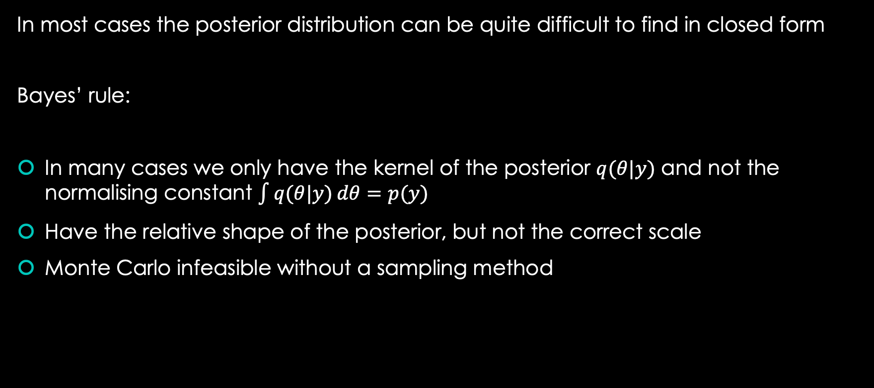
Unknown posteriors
In most cases the posterior distribution can be quite difficult to find in closed form
Bayes’ rule:
In many cases we only have the kernel of the posterior $q(θ|y)$ and not the normalising constant $\int{q(θ|y)}dθ=p(y)$
Have the relative shape of the posterior, but not the correct scale
Monte Carlo infeasible without a sampling method
$$p\left(θ | x\right)= \frac{p\left(x | θ\right)p(θ)}{p\left(x\right)}=\frac{p(θ,x)}{\int{p(θ,x)dθ}}=\frac{q(θ|x)}{\int{q(θ|x)dθ}}$$

Slide 19
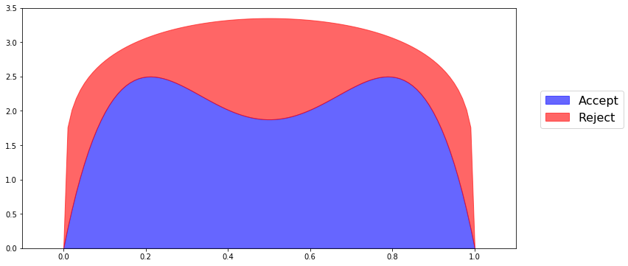
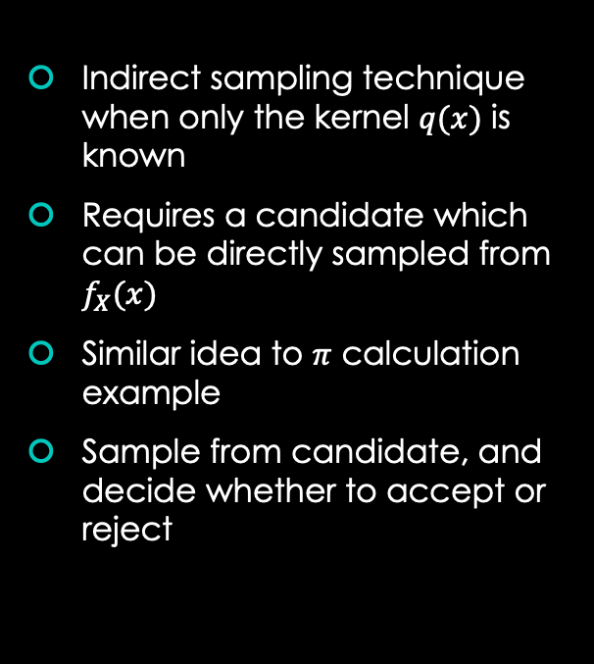
Rejection sampling
Indirect sampling technique when only the kernel $q(x)$ is known
Requires a candidate which can be directly sampled from $f_{X}(x)$
Similar idea to $π$ calculation example
Sample from candidate, and decide whether to accept or reject

Slide 20
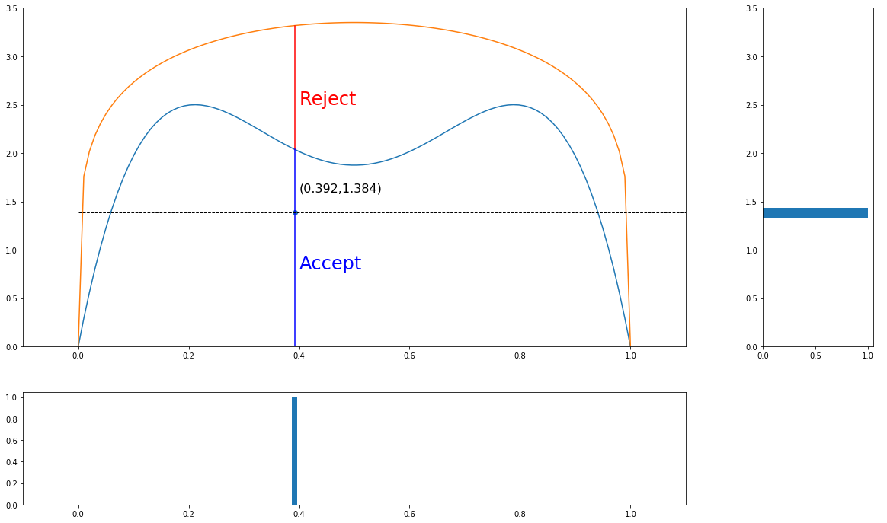

Slide 21
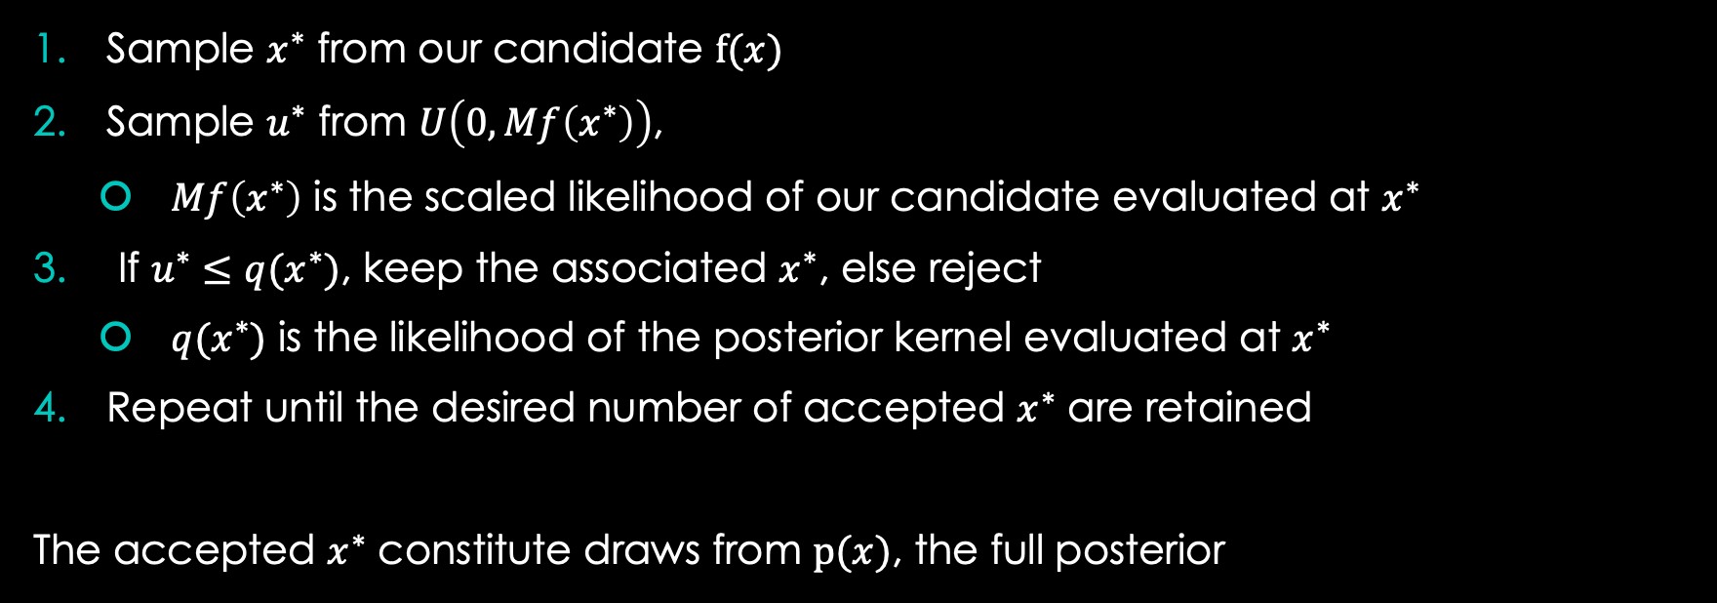
Rejection Sampling: the Details
Sample $x^{∗}$ from our candidate $f(x)$
Sample $u^{∗}$ from $U\left(0, Mf\left(x^{∗}\right)\right)$,
$Mf\left(x^{∗}\right)$ is the scaled likelihood of our candidate evaluated at $x^{∗}$
If $u^{∗}≤q(x^{∗})$, keep the associated $x^{∗}$, else reject
$q(x^{∗})$ is the likelihood of the posterior kernel evaluated at $x^{∗}$
Repeat until the desired number of accepted $x^{∗}$ are retained
The accepted $x^{∗}$ constitute draws from $p(x)$, the full posterior

Slide 22
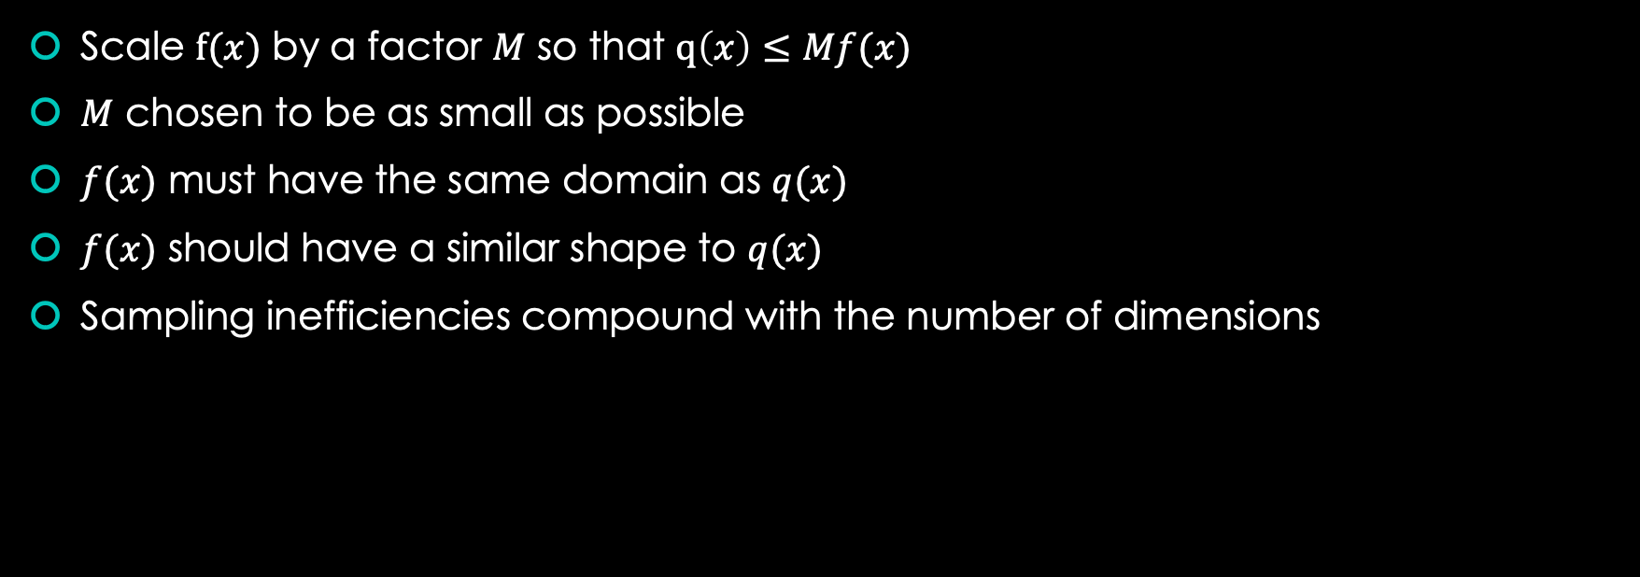
Picking a candidate distribution
Scale $f(x)$ by a factor $M$ so that $q\left(x\right)≤Mf(x)$
$M$ chosen to be as small as possible
$f(x)$ must have the same domain as $q(x)$
$f(x)$ should have a similar shape to $q(x)$
Sampling inefficiencies compound with the number of dimensions

Slide 23
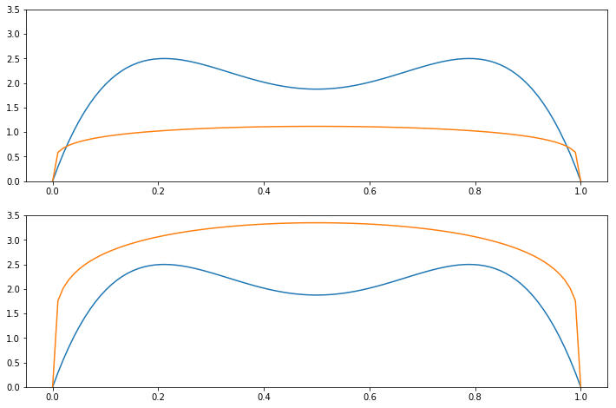

Slide 24

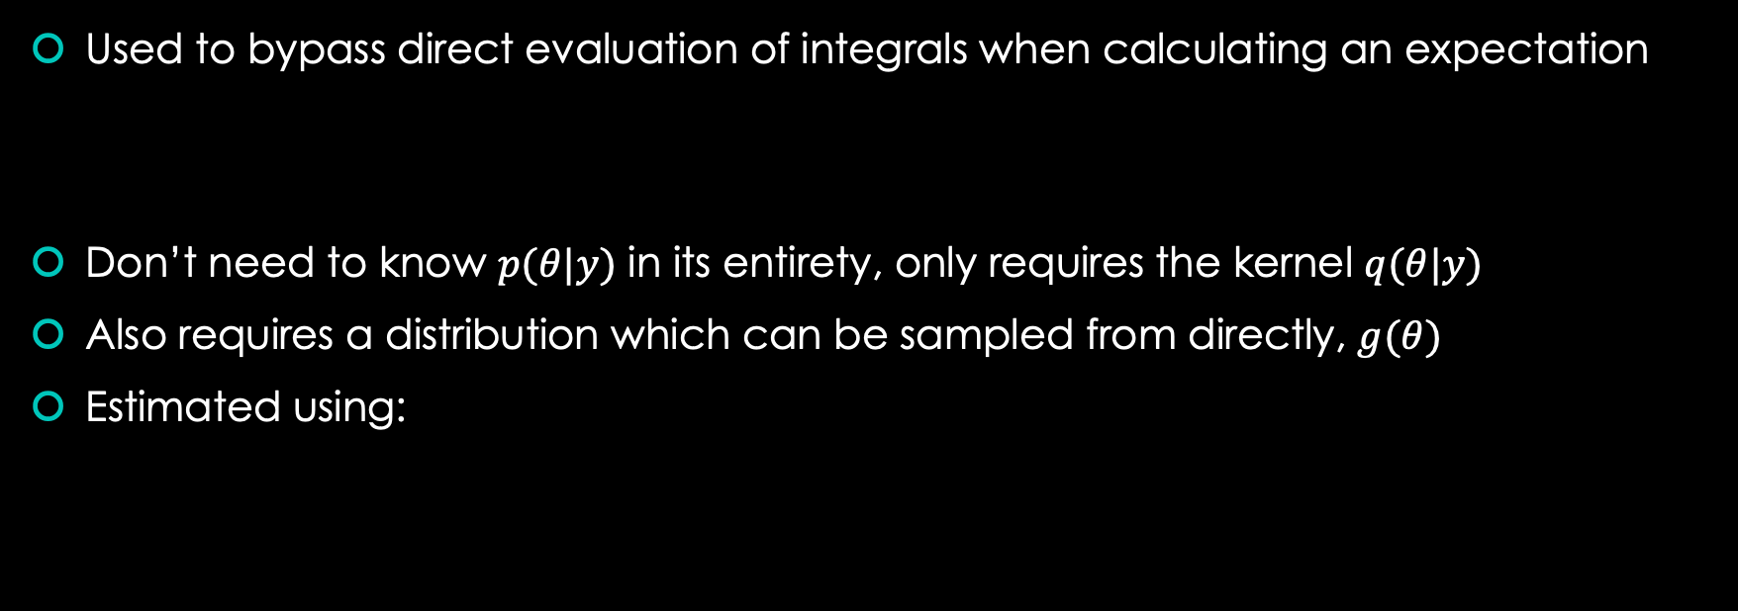

Importance sampling
Used to bypass direct evaluation of integrals when calculating an expectation
Don’t need to know $p(θ|y)$ in its entirety, only requires the kernel $q(θ|y)$
Also requires a distribution which can be sampled from directly, $g(θ)$
Estimated using:
$$E\left(h\left(θ\right) | y\right)=\int{h\left(θ\right)p\left(θ | y\right)dθ}$$
$$\frac{\frac{1}{S}\sum_{s=1}^{S}{h\left(θ_{s}\right)\frac{q(θ_{s}|y)}{g(θ_{s})}}}{\frac{1}{S}\sum_{s=1}^{S}{\frac{q(θ_{s}|y)}{g(θ_{s})}}}=\frac{\frac{1}{S}\sum_{s=1}^{S}{h\left(θ_{s}\right)w(θ_{s})}}{\frac{1}{S}\sum_{s=1}^{S}{w(θ_{s})}}, where w\left(θ_{s}\right)=\frac{q(θ_{s}|y)}{g(θ_{s})}$$

Slide 25


The Mathematics Behind Importance Sampling
The numerator and denominator can be estimated using simple Monte Carlo
$$E\left(h\left(θ\right) | x\right)=\int{h\left(θ\right)p\left(θ | x\right)dθ}=\int{h\left(θ\right)\frac{q(θ|x)}{\int{q(θ|x)dθ}}dθ}=\frac{\int{h\left(θ\right)q\left(θ | x\right)}dθ}{\int{q(θ|x)dθ}}$$
$$\frac{\int{\frac{h\left(θ\right)q\left(θ | x\right)}{g\left(θ\right)}g(θ)}dθ}{\int{\frac{q\left(θ | x\right)}{g\left(θ\right)}g(θ)dθ}}=\frac{\int{h\left(θ\right)w(θ)g(θ)}dθ}{\int{w(θ)g(θ)dθ}}=\frac{E_{g}[h\left(θ\right)w\left(θ\right)]}{E_{g}[w(θ)]}$$

Slide 26
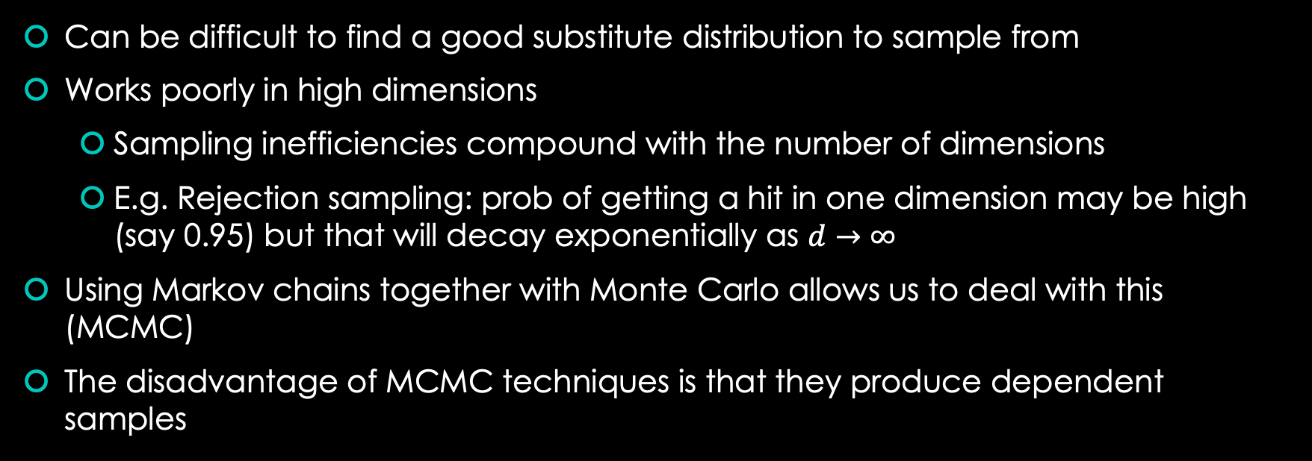
Why do we need Markov Chains?
Can be difficult to find a good substitute distribution to sample from
Works poorly in high dimensions
Sampling inefficiencies compound with the number of dimensions
E.g. Rejection sampling: prob of getting a hit in one dimension may be high (say 0.95) but that will decay exponentially as $d→∞$
Using Markov chains together with Monte Carlo allows us to deal with this (MCMC)
The disadvantage of MCMC techniques is that they produce dependent samples

Slide 27
Additional Links
GitHub: https://github.com/hxyue1/mcmc
Bayesian Methods for Hackers: https://github.com/CamDavidsonPilon/Probabilistic-Programming-and-Bayesian-Methods-for-Hackers
Bayesian Data Analysis: http://www.stat.columbia.edu/~gelman/book/

